Slide 1

Design and analysis of algorithms (CSE 2012)
Prepared by
Dr.S.Jenicka
Assistant professor senior grade 2
SCOPE-Analytics
VIT Vellore

Slide 2

Capacity constraint
Flow from a vertex i to j (x_{ij} ) can range from 0 to the capacity value along the edge (u_{ij} ) where E is the set of edges in the graph

Slide 3
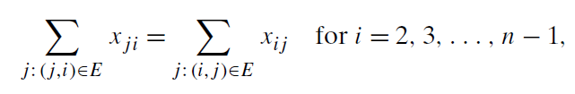
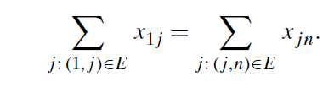
Flow conservation constraint
The total amount of flow going out of a vertex (other than source and sink) will be equal to total amount of flow coming into a vertex
Where n is the total number of vertices in the graph. The outflow from a source (x_{1j} ) is equal to the inflow into the sink (x_{jn} )

Slide 4
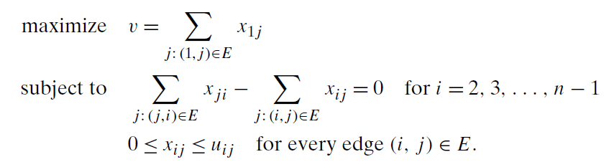
Maximum flow problem

Slide 5
Marking reverse flow in the Network flow graph
When a flow is sent from u to v in the forward direction, it is always possible to bring it back if we want in the opposite direction. That’s why for every flow in the forward edge, we have capacity of the same magnitude in the backward edge.
f(u,v)
u
v
C=f(u,v)

Slide 6
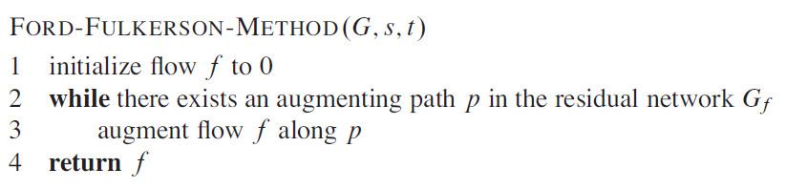
Ford Fulkerson algorithm

Slide 7
Runtime complexity of Edmond Karps algorithm
For the flow graph G(V,E), since the residual network consists of all edges E’ with U(u,v)>0, the time taken to find a path in the residual network is O(V+E’)= O(E) if we use BFS.
If f* denotes a maximum flow in the transformed network, then a straightforward implementation of FORD-FULKERSON executes the while loop at most |f*| times, since the flow value increases by at
least one unit in each iteration.
So time taken by FORD-FULKERSON algorithm is O(E|f*|)

Slide 8
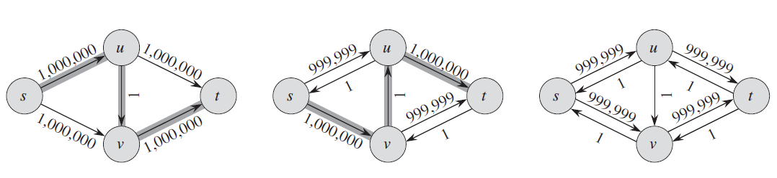
To calculate running time of Edmonds Karps algorithm

Slide 9
-Contd
How to find the time complexity of BFS?
Property of BFS: The number of edges in the given augmented path will be same or greater than the total number of edges in the previous augmented path.
The total number of edges from source to sink in the worst case will be total number of vertices.
Time complexity for BFS= O(E)
Note:
If f* denotes a maximum flow, according to our previous discussion, it should be equal to the number of augmenting paths.
So time complexity of Ford Fulkerson Edmonds Karp algm= O( E* Total number of augmented paths)

Slide 10
Critical path
We say that an edge (u,v) in a residual network is critical on an augmenting path p if the residual capacity of p is the residual capacity of (u,v) that is, if U(p)= U(u,v).
After we have augmented flow along an augmenting path,
any critical edge on the path disappears from the residual network. Moreover, at least one edge on any augmenting path must be critical. We will show that each of
the |E| edges can become critical at most |V|/2 times.

Slide 11
-Contd
So we need to find out how many augmented paths we have. Every augmented path has a critical edge. How many times an edge becomes a critical edge?
An edge becomes critical only V/2 times
Total number of critical edges = E*V/2
Every augmented path has a critical edge.
So in the worst case the number of augmented paths = V*E
BFS takes O(E) time
So time complexity of Edmonds Karp
algorithm = O(VE*E)= O(VE²)

Slide 12
Time Complexity of Ford Fulkerson algorithm
Ford Fulkerson uses DFS for finding augmenting path. Time complexity of Ford Fulkerson algorithm = O(V²E) where time complexity of DFS is O(V)

Slide 13
Max Flow Min cut theorem

Slide 14
Push Relabel algorithm- Steps
Push-Relabel Algorithm
1) Initialize PreFlow : Initialize Flows
and Heights
2) While it is possible to perform a Push() or
Relablel() on a vertex
// Or while there is a vertex that has excess flow
Do Push() or Relabel()
// At this point all vertices have Excess Flow as 0 (Except source
// and sink)
3) Return flow.

Slide 15
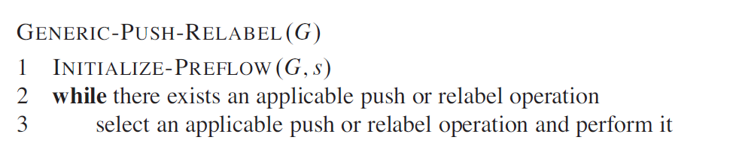
Push Relabel algorithm as in CLRS book

Slide 16
Preflow operation -Steps
Preflow()
1) Initialize height and flow of every vertex as 0.
2) Initialize height of source vertex equal to total
number of vertices in graph.
3) Initialize flow of every edge as 0.
4) For all vertices adjacent to source s, flow and
excess flow is equal to capacity initially.

Slide 17
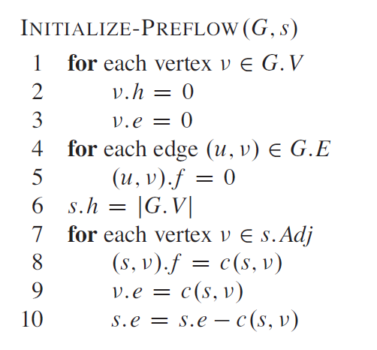
Preflow operation as in CLRS book

Slide 18
Push operation- Function
Push() is used to make the flow from a node which has excess flow.
If a vertex has excess flow and there is an adjacent with smaller height (in residual graph), we push the flow from the vertex to the adjacent with lower height.
The amount of pushed flow through the pipe (edge) is equal to the minimum of excess flow and capacity of edge.
Note:
1.When there are more than one vertex with excess flow, flow will be pushed by the vertex with maximum height. If the vertices with excess flow are at the same height, one vertex is arbitrarily chosen.
2. The flow is always pushed downhill (to a vertex with minimum height). If there are more than one adjacent vertices downhill at the same minimum height, then also a vertex is arbitrarily chosen and the flow is pushed to it.

Slide 19
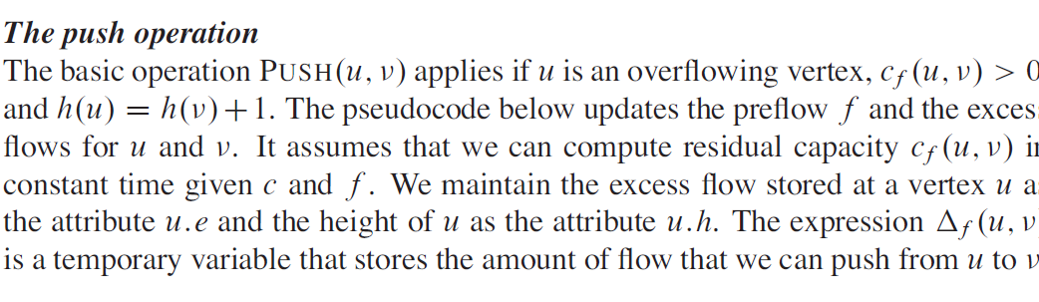
Push operation-Description

Slide 20
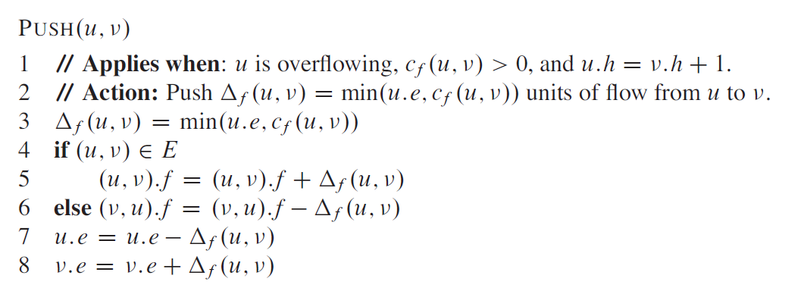
Push operation algorithm as in CLRS book

Slide 21
Relabel operation- Function
Relabel() operation is used when a vertex has excess flow and none of its adjacent is at lower height.
We basically increase height of the vertex so that we can perform push().
To increase height, we pick the minimum height adjacent (in residual graph, i.e., an adjacent vertex to whom we can add flow) and add 1 to it.

Slide 22
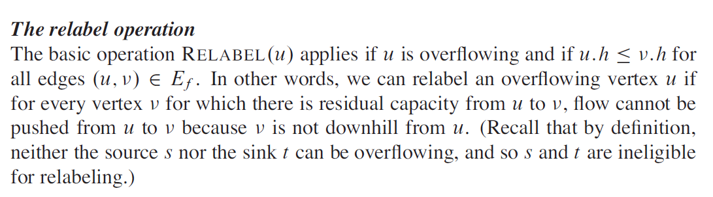
Relabel operation-Description

Slide 23
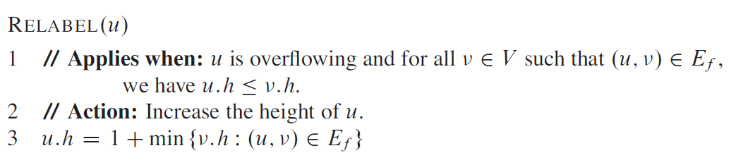
Relabel operation as in CLRS book

Slide 24
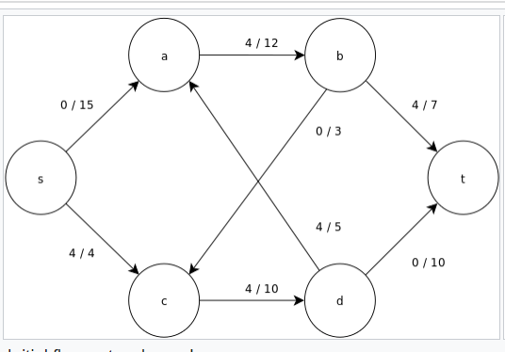
Network flow graph

Slide 25
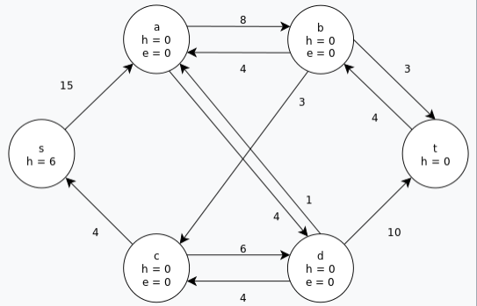
Initialise the residual graph by setting the preflow to values 0 and initialising the labeling.

Slide 26
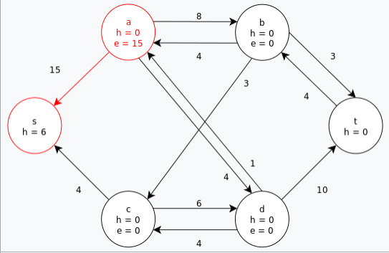
Initial saturating push is performed across all preflow arcs out of the source, s.

Slide 27
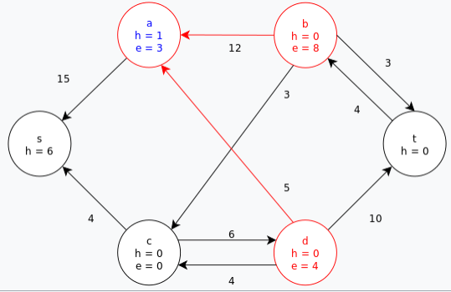
Node a is relabeled in order to push its excess flow towards the sink, t. The excess at a is then pushed to b then d in two subsequent saturating pushes; which still leaves a with some excess.

Slide 28
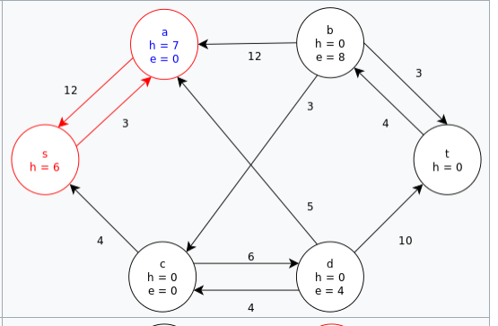
Once again, a is relabeled in order to push its excess along its last remaining positive residual (i.e. push the excess back to s).The node a is then removed from the set of active nodes.

Slide 29
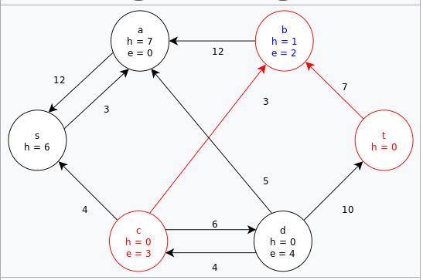
Relabel b and then push its excess to t and c.

Slide 30
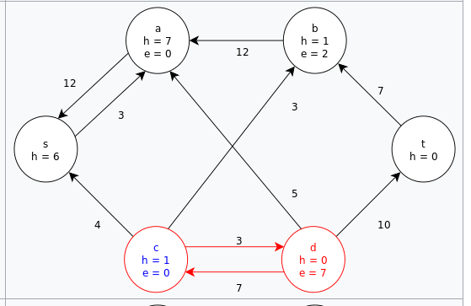
Relabel c and then push its excess to d.

Slide 31
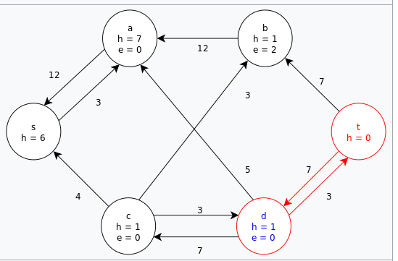
Relabel d and then push its excess to t.

Slide 32
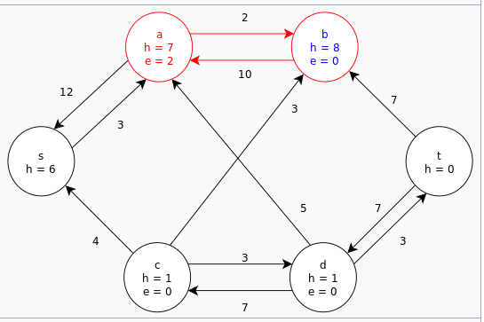
This leaves the node b as the only remaining active node, but it cannot push its excess flow towards the sink. Relabel b and then push its excess towards the source, s, via the node a.

Slide 33
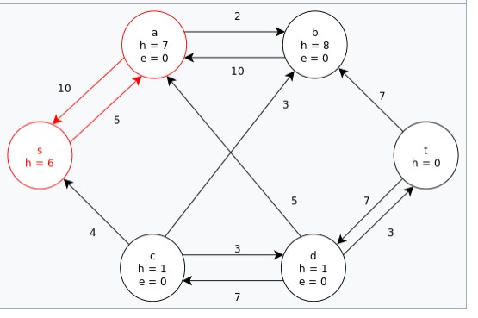
Push the last bit of excess at a back to the source, s.There are no remaining active nodes. The algorithm terminates and returns the maximum flow of the graph (as seen above).

Slide 34
Time complexity of push relabel algorithm
In sum, the algorithm executes O(V ²) relabels, O(VE) saturating pushes and O(V ²E) nonsaturating pushes.
Time complexity=O(V²E)

